Slide 1
COMP3331/9331
Tut 02 Rui
22T1

Slide 2
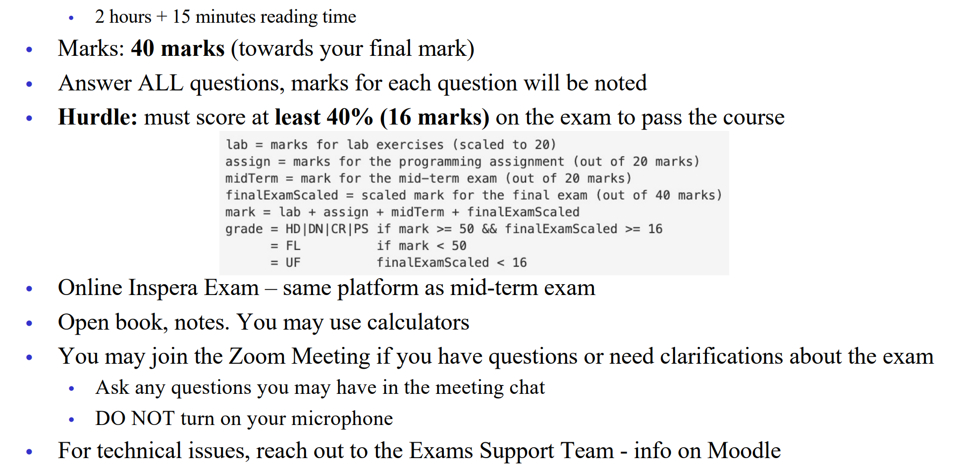
Final exam general info
Thursday 5th May from 09:45 to 12:00 Sydney time online (Inspera)

Slide 3
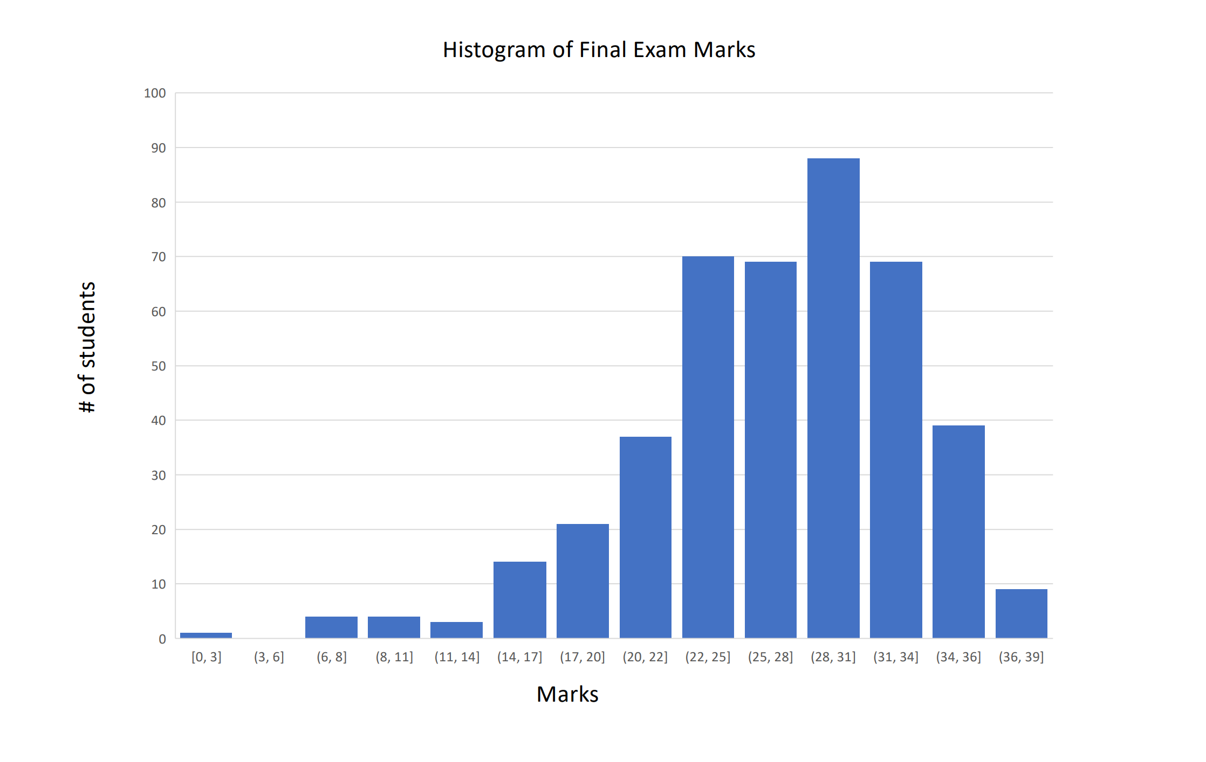
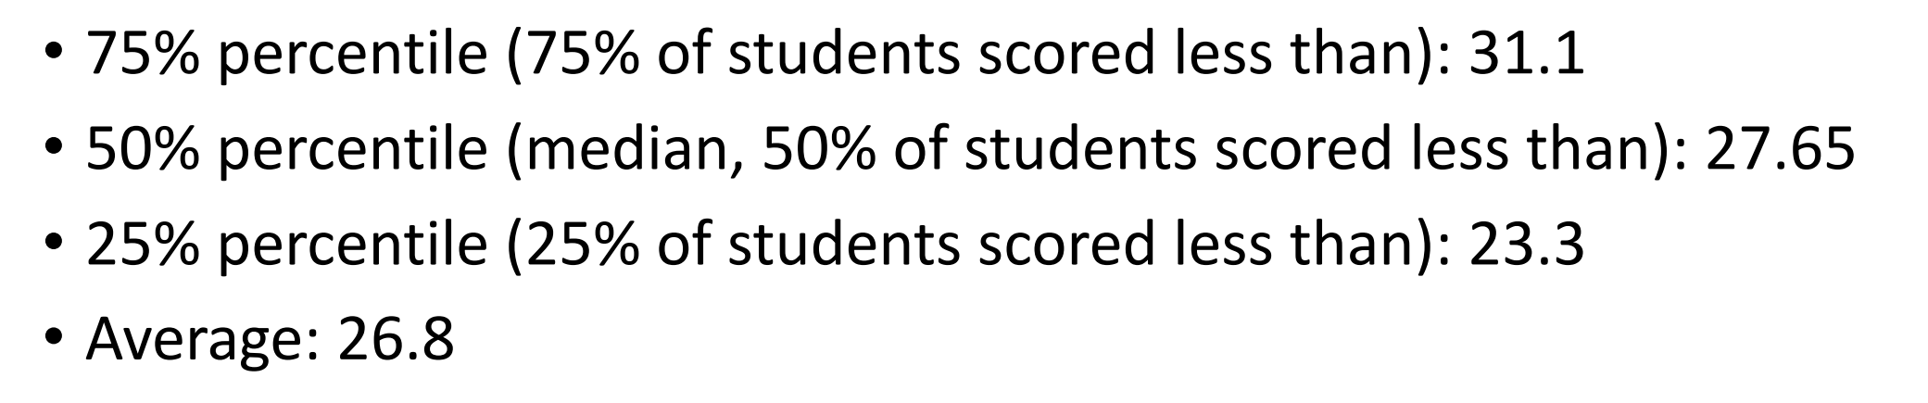
Final Exam Statistics
From last term

Slide 4
Question Type
Type | Level | Percentage
Multiple-choices | Easy | ~20%
Calculation (Text entry) | Easy - Medium | ~20%
Short answer/Essay | Medium – Hard | >60%

Slide 5
Tested area
Knowledge point | Possible question type | Percentage
TCP | All | ~30%
IP | ALL | ~35%
LinkLayer/Switches | Short Answer | ~15%
Wireless | Short Answer | 10~15%
Security | Short Answer | 10~15%

Slide 6
Tested area
Transport layer (esp. TCP)
Calculation
Pipeline protocols
Congestion Control
Path
Network layer (IP)
Addressing
Fragmentation
Allocation
Routing protocols and algorithms: link state, distance vector
LinkLayer
Switches
Wireless
frame collisions (RTC/CTS etc.)
Security
Open minded question (free marks)

